Slide 1
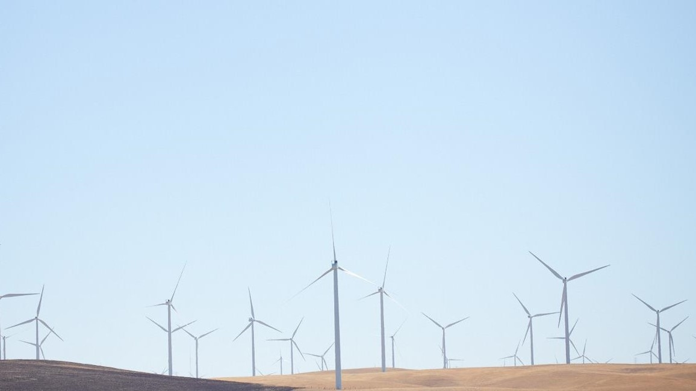

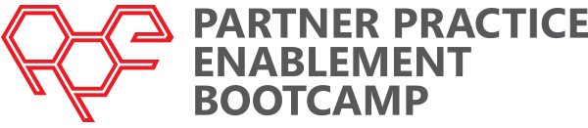
IoT Tech Training – Module One
Speaker details here

Slide 2
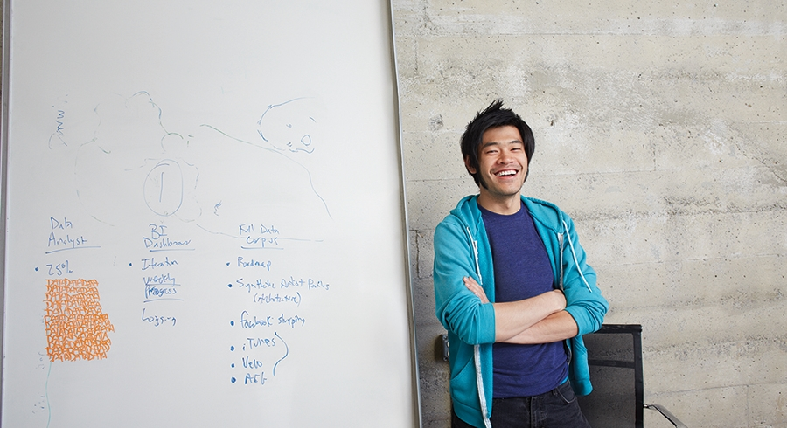



Welcome and overview

Slide 3
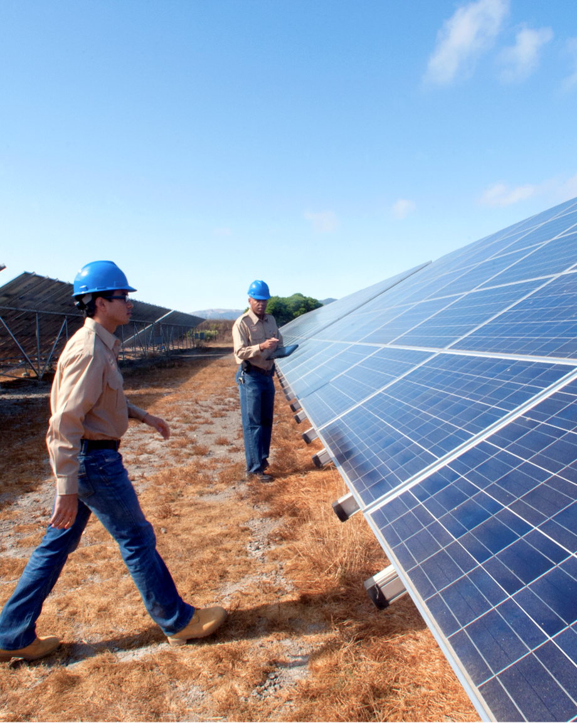
Agenda
Workshop Goals
Opportunities & Challenges
IoT Devices & Cloud Patterns
IoT Related Azure Offerings
IoT Suite
IoT Suite Components & Structure
Azure Streaming Analytics
Case Studies

Slide 4
Workshop Goals
Gain an overview of Azure IoT Suite & Azure IoT Hub
Provide architectural overview of key components
Put IoT components in context of broader Azure story
Get attendees hands on quickly to make it 'real'

Slide 5
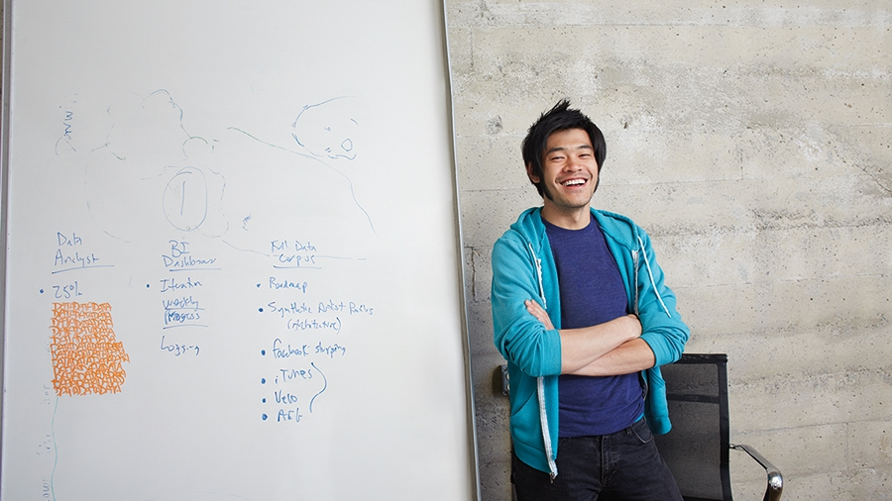


Opportunities & Challenges

Slide 6
IoT is an Inflection Point
Hardware
is cheap
Connectivity
is pervasive
Development
is easy
Cloud can deal with big data
New Innovative Scenarios

Slide 7
IoT 2010
Alarm clock
Refrigerator
Automobile
VoIP phone
Computer
Printer
Media player
Microwave
HOME
WORKPLACE
HOME
Coffee maker
Smart scale
Oven
Cell phone
HVAC
Vending
Security
Television

Slide 8

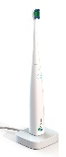
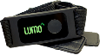
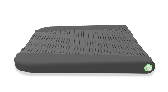
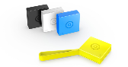
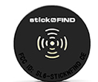
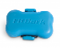

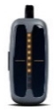
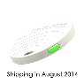
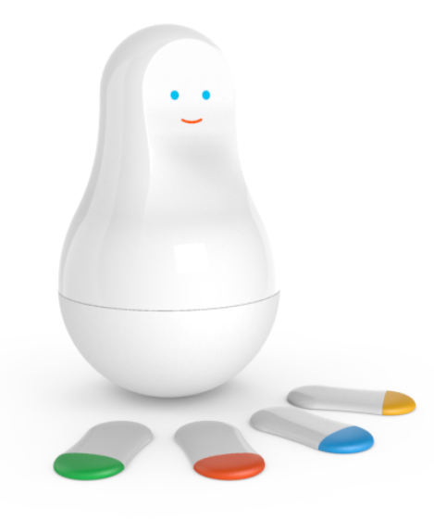
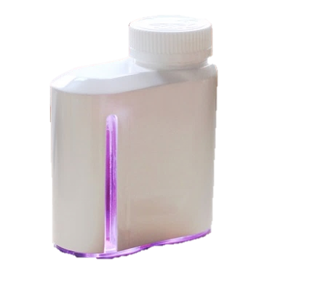
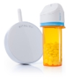
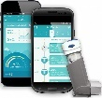
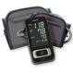
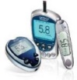
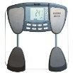
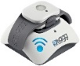
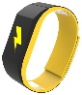
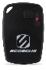
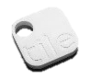
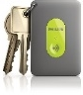
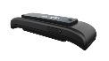
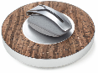

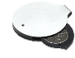
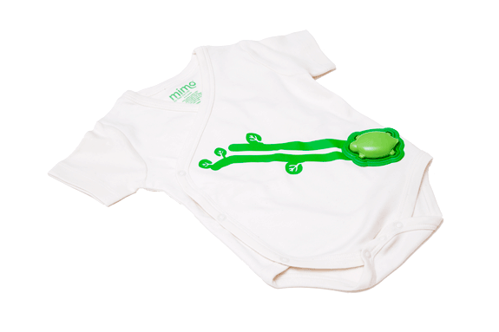
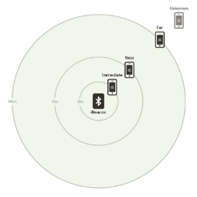
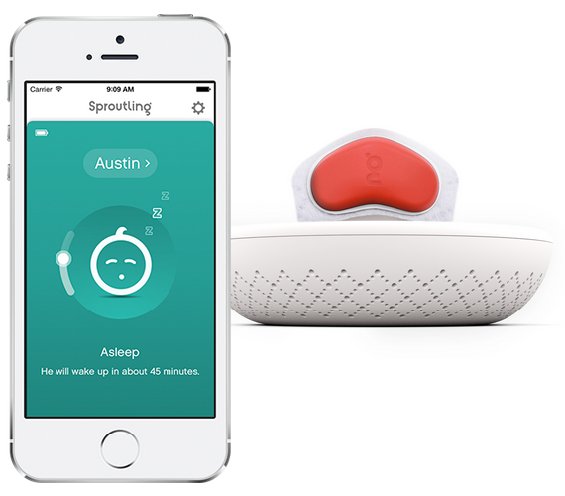

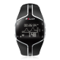
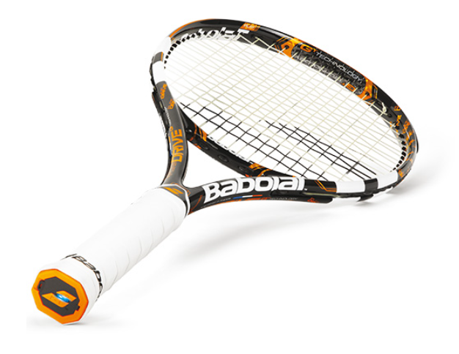
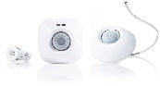
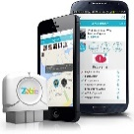
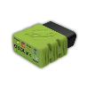
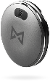
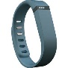
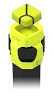
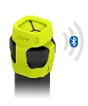
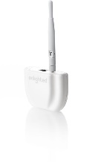
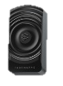

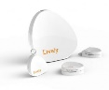
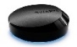
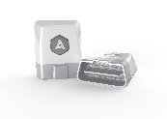
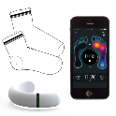
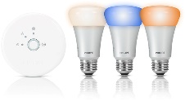
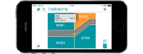
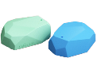

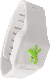




















































IoT 2016
Medication adherence
Health monitoring
Pet tracking
Behavior modification
Object tracking
Child and elder monitoring
Sports and fitness
Indoor navigation
Trip tracking and car health
Smart lighting
Beacons and proximity
COMMUTE
COMMUTE
HOME
WORKPLACE
HOME
Smart appliances
Food and nutrition tracking
Identity
Office equipment
Smart vending machines
Bike ride stats and protection
Air conditioning and temperature control
Sleep tracking
Environmental sensors
Information capture
Control
Home security
Home automation
Leak detection
Garden, lawn and plant care
New devices and sensors
Entertainment systems

Slide 9

25 BILLION Connected “things” will be in use by 2020
$7.2 TRILLION worldwide market for IoT solutions by 2020
IDC: Worldwide and Regional Internet of Things (IoT) 2014–2020 Forecast
Gartner

Slide 10

Disruptive Forces
Moore’s Law
Metcalf‘s Law
Koomey’s Law
Transistors
Computations
per KWh
10,000,000,000
1.E+14
1,000,000,000
1.E+12
100,000,000
1.E+10
10,000,000
1.E+08
1,000,000
1.E+06
100,000
1.E+04
10,000
1.E+02
1,000
1.E+00
1970
1980
1990
2000
2010
1940
1975
2010
And more importantly:
what can you do by combining and analyzing signals from all of these IoT devices?

Slide 11
IoT Business Maturity Model 1. Operational efficiency
Connect devices and monitor telemetry
Monitor and track device state, location and health
Things
Rules and alerting to improve operational efficiency

Slide 12
IoT Business Maturity Model 2. Business Intelligence
Analyze and visualize data from devices
Discover patterns in device data using predictive analytics
Things
Operationalize insights to improve things and processes in real time

Slide 13
IoT Business Maturity Model 3. Business Transformation
Combine IoT & other data with advanced analytics to power new services and revenue streams
Expand into new adjacent businesses
Things
New partnership opportunities

Slide 14







IT / OT Collaboration
Operational Technology (OT)
Information Technology (IT)

Slide 15
IT / OT Collaboration Enables IoT
Enterprise

Slide 16
Collaboration & Cyberphysical Security
IT Engineers
OT Engineers
Know how to make digital things secure.
Secure Development Lifecycle
Secure Network Technologies
Threat & Vulnerability Mitigation
Monitoring and Alerting
Software/Firmware Auto-Updates
Privacy Models
Know how to make physical things safe and secure
Standards, Procedures, Training, Continuous Improvement
Physical access management
Hazard and Risk Analysis
Monitoring and Maintenance
Fail Safe and Safety Equipment
IT and OT engineers will collaborate in making “cyberphysical” systems safe and secure.

Slide 17
IoT Devices & Cloud Patterns

Slide 18
Cloud Based IoT Solutions
Azure IoT
Easy to provision, use and manage
Pay as you go, scale as you need
Global reach, hyper scale
End to end security & privacy
Three parts of an IoT solution
1 | Device connectivity & management
2 | Analytics & operationalized insights
3 | Presentation & business connectivity

Slide 19
IoT Device & Cloud Patterns
Cloud Gateway
Event/IoT Hubs
Event Hubs
High scale telemetry ingestion service
HTTP/AMQP protocol support
Each Event Hub supports
1 million publishers
1GB/s ingress
Generally available worldwide
Tens of Billions of messages per day
Tens of TB ingested per day
And rising…
Devices
RTOS, Linux, Windows, Android, iOS

Slide 20
IoT Device & Cloud Patterns
Cloud Gateway
Event Hubs
&
Azure IoT Hub
Additional IoT Needs
Command & control
Device identity
Device registry
Device and State management
Protocol translation and gateways
Protocol Adaptation
Field Gateway
Protocol Adaptation
Devices
RTOS, Linux, Windows, Android, iOS
Field Gateway
Device
Connectivity & Management

Slide 21
IoT Device & Cloud Patterns
Azure IoT Hub
Bi-directional device <-> cloud
Up to 10 million devices
Telemetry ingestion
Command & control
Device registry & identity
Bulk import/export of device identities
Device Management
HTTP/AMQP/AMQP-WS/MQTT
Extensible protocol support
Operations Monitoring
Cloud Gateway
Azure IoT Hub
Protocol Adaptation
Field Gateway
Protocol Adaptation
Devices
RTOS, Linux, Windows, Android, iOS
Field Gateway
Device
Connectivity & Management

Slide 22
IoT Device & Cloud Patterns
Cloud Gateway
Event Hubs
&
Azure IoT Hub
Cross-Platform
Device Support
Open source “agent” framework
Simple, secure device <-> cloud connectivity & management
RTOS, Linux, Windows, Android, iOS
Easy to use, not required
Protocol Adaptation
Field Gateway
Protocol Adaptation
Devices
RTOS, Linux, Windows, Android, iOS
Field Gateway
C API
.NET API
Java API
Javascript API
Cross Platform C Code
Device
Connectivity & Management
OS Abstraction Layer / OS Bindings

Slide 23





IoT Device & Cloud Patterns
Batch Analytics & Visualizations
Azure HDInsight, AzureML, Power BI,
Azure Data Factory, Azure Data Lake
Cloud Gateway
Event Hubs
&
Azure IoT Hub
Hot Path Analytics
Azure Stream Analytics, Azure HDInsight Storm
Protocol Adaptation
Hot Path Business Logic
Service Fabric & Actor Framework
Operationalize your insights in real time
Field Gateway
Protocol Adaptation
Devices
RTOS, Linux, Windows, Android, iOS
Find insights to
Power new services
Improve your “things”
IoT Scale
Object Models & Business Logic
Field Gateway
Device
Connectivity & Management
Analytics &
Operationalized Insights

Slide 24

IoT Device & Cloud Patterns
Batch Analytics & Visualizations
Azure HDInsight, AzureML, Power BI,
Azure Data Factory, Azure Data Lake
Cloud Gateway
Event Hubs
&
Azure IoT Hub
Hot Path Analytics
Azure Stream Analytics, Azure HDInsight Storm
Presentation &
Business Connectivity
App Service, Websites
Dynamics, BizTalk Services, Notification Hubs, Logic Apps
Protocol Adaptation
Hot Path Business Logic
Service Fabric & Actor Framework
Field Gateway
Protocol Adaptation
Devices
RTOS, Linux, Windows, Android, iOS
Field Gateway
Device
Connectivity & Management
Analytics &
Operationalized Insights
Presentation &
Business Connectivity

Slide 25
IoT Related Azure Offerings

Slide 26
Azure IoT Reference Architecture
Devices and Data Sources
Data Transport
Device and Event Processing
Presentation
Cloud Gate-way
Data Visualization & Presentation
IP capable devices
Provisioning API
Solution Portal
Device State Store
Agent Libs
Identity & Registry Stores
Existing IoT devices
Stream Event Processor
Agent Libs
Gateway
Storage
Analytics/ Machine Learning
Low power devices
Agent Libs
Control System Worker Role

Slide 27
















Microsoft Azure IoT services
Devices | Device Connectivity | Storage | Analytics | Presentation & Action
 | Event Hubs | SQL Database | Machine Learning | App Service
 | IoT Hubs | Table/Blob Storage | Stream Analytics | Power BI
 | Service Bus | DocumentDB | HDInsight | Notification Hubs
 | External Data Sources | External Data Sources | Data Factory | Mobile Services
 |  |  |  | BizTalk Services
{ }

Slide 28
Azure IoT Reference Architecture
Devices and Data Sources
Data Transport
Device and Event Processing
Presentation
Cloud Gate-way
Data Visualization & Presentation
IP capable devices
Provisioning API
Solution Portal
Device State Store
Agent Libs
Identity & Registry Stores
{ }
Existing IoT devices
Stream Event Processor
Agent Libs
Gateway
Storage
Analytics/ Machine Learning
Low power devices
Agent Libs
Control System Worker Role

Slide 29
IoT Suite

Slide 30
Microsoft Azure IoT Suite
Connect and scale
with efficiency
Analyze and act
on new data
Integrate and transform
business processes
Preconfigured solutions
Event processing
Workflow integration
Heterogeneous agents
Predictive analytics
Push and broadcast notifications
Connect and control
Data visualization
ID and access management

Slide 31








Microsoft Azure IoT Suite
Accelerate your business transformation
Azure IoT services
Azure IoT Suite
Enables you to
Connect assets
Mine data
Take action
Addresses
common scenarios:
Monitoring
Remote Monitoring
Predictive Maintenance
And more…

Slide 32



Accelerate time to value with preconfigured solutions
Start quickly with preconfigured solutions
Finish with your Internet of Things application
Get started in minutes
Fine-tuned to specific assets and processes
Modify existing rules and alerts
Highly visual for your real-time operational data
Add your devices and begin tailor to your needs
Integrate with back-end systems

Slide 33
What you get with remote monitoring preconfigured solution
Azure IoT Suite Remote Monitoring
Web/Mobile App
Power BI
Devices
Back end systems and processes
Storage blobs
DocumentDB
C# simulator
IoT Hub
Stream Analytics
Event Hub
Web Jobs
Logic Apps
Azure
Active Directory

Slide 34
IoT Suite Components & Structure

Slide 35
Solution Architecture
Azure IoT Suite Remote Monitoring
Web/Mobile App
Power BI
Devices
Back end systems and processes
Storage blobs
DocumentDB
C# simulator
IoT Hub
Stream Analytics
Event Hub
Web Jobs
Logic Apps
Azure
Active Directory

Slide 36
Azure Streaming Analytics

Slide 37



ASA – Benefits
Allows event processing of large volumes of event data at high velocity
Analysis is done as data arrives
Declarative ‘SQL like’ query processing support
High throughput, low latency processing
Real-time stream computation options
Enable rapid development

Slide 38
ASA - Inputs
Data stream inputs
Event Hub: Feed events into Azure in real time, and Stream Analytics jobs can process them
IoT Hub: Stream information collected from connected devices directly into a streaming analytics job
Blob Storage: Can be used as an input source for ingesting bulk data
Reference Data
Static or slow changing used for performing look-ups
Azure Blob Storage is the only supported reference input
Source blobs limited to 50MB in size
Input Data Types
CSV, JSON and Avro Serialized

Slide 39

ASA - Queries
Performs transformations and computations over streams of events
Stream Analytics Query Language
Subset of T-SQL syntax
Multiple built-in functions
Supports multiple data types as well as complex
3 types of windowing
Tumbling
Hopping
Sliding
Queries can be created via Azure Portal or via API calls

Slide 40
ASA - Outputs
Multiple options for storing output and viewing analysis results Route to one or more outputs
Flexibility in the consumption and storage of the job output for data warehousing and other purposes
Available Outputs:
SQL Database
Blob Storage
Event Hub
Power BI
Table Storage
Service Bus Queues and Topics
Document DB
Azure Data Lake(Preview)

Slide 41

ASA – IoT Suite Usage
Remote Monitoring Solution – Three ASA Jobs
1. Route all telemetry to Blob Storage
Saves all stream data that is used to create telemetry chart
2. Route Command Response and Device Status messages
Identifies and routes Command Response and Device Status messages to an EventHub for further processing
3. Rules
Queries telemetry stream against rules
E.g. Uses 5 minute sliding window to get min/max/average of humidity

Slide 42

ASA – Management
Portal
Inputs/Queries/Outputs
Scale & Resource Management
Start/Stop Jobs
Other admin options
Code
.NET SDK reference
REST endpoint available
ARM via Azure PowerShell

Slide 43

ASA – Scalability
Streaming Units: represent the resources and power to execute an Azure Stream Analytics job
Each streaming unit corresponds to roughly 1MB/second of throughput.
You can select up to your quota in streaming units for a job by using the Azure portal
Number of SU’s used by a job depends on number of steps in a query and partitions defined on each step

Slide 44
Case Studies

Slide 45


Fueling the oil and gas industry with IoT
CHALLENGE
SOLUTION
BENEFITS
Rockwell Automation is the world’s largest industrial automation and information firm with 22,500 employees and customers in more than 80 countries. Rockwell Automation wanted to transform the way they do business in the oil and gas industry by bringing the data generated by even the most remote assets into the cloud and using advanced analytics to provide unprecedented business insights.
Rockwell Automation created a solution to monitor expensive capital assets and use that data to improve operational efficiency, drive better performance and enable innovation. Based on Microsoft Azure Internet of Things services, the solution collects, integrates, and organizes sensor data from remote equipment across global supply chains to support real-time insight, predictive analytics, and preventive maintenance.
Improves access to production and supply chain data worldwide, reducing downtime costs by as much as $300,000 per day
Modernizes transaction data by replacing a paper-based system with immediate electronic records
Enables data insights that help customers orchestrate everything from deliveries to equipment maintenance
“What we’re talking about is delivering a degree of collaboration and visibility unheard of in the oil and gas industry.”
Doug Weber Business Manager, Remote Application Monitoring
ROCKWELL AUTOMATION

Slide 46


Transforming subatomic research with IoT
CHALLENGE
SOLUTION
BENEFITS
Operated by Stanford University for the United States Department of Energy, the SLAC National Accelerator Laboratory is a 50-year-old, two-mile-long particle accelerator and research center. Over the years, six scientists have received Nobel prizes for work conducted there. To ensure continuous availability of this critical scientific resource and keep it running as smoothly as the day it was built, SLAC teams are collaborating to explore the Internet of Things (IoT).
SLAC is collecting data from intelligent sensors and feeding it into the cloud where it can be analyzed for early detection of anomalies — allowing engineers to anticipate problems, take action and prevent failure. Working with Microsoft Open Technologies, SLAC used the open-source project ConnectTheDots.io to integrate the diverse array of sensor formats in one of its klystron cooling systems. Azure Event Hubs then packages and routes the data to Azure Machine Learning for near-real-time analysis.
Keeps science accelerating by collecting and analyzing potentially millions of data points in near-real time to predict potential failure
Helps technicians understand how disparate systems interoperate, so they can upgrade more strategically and avoid downtime
Continually increases precision by feeding information back into Azure Machine Learning on the root causes of detected anomalies
“The advantage we gain is that the algorithms can look through everything at once and just return the things we actually need to focus on, so we can take action.
Marcus Keenan
Manager of Instrumentation and Controls for Facilities and Operations
SLAC National Accelerator Laboratory

Slide 47

Using IoT to flush out inefficient processes for Monterey Water
CHALLENGE
SOLUTION
BENEFITS
The Monterey Regional Water Pollution Control Agency is one of the nation’s largest water recycling facilities for crop irrigation—treating 20 million gallons daily. Monterey wanted to find out why their facility was experiencing unusually high energy usage but didn’t have the data necessary from their existing control systems. They wanted to avoid expanding their existing control system —taking many months and hundreds of thousands of dollars—opting to seek an IoT solution instead.
Candi Controls created a solution for MRWPCA that was running within 30 days and that cost less than $40K. Commercial-class IoT submeters were placed at 20 key plant processes to measure energy usage at 30 second intervals providing the granular, real-time data Monterey Water needed to optimize plant processes. The existing deployment is being enhanced with Azure Stream Analytics and Power BI to better manage and optimize energy usage in future.
Provided $160K in deployment savings and was up and running within 30 days, needing only onsite electricians to install.
Created 140,000 data points daily, enabling analyses of inefficient processes to save energy costs.
Expansion of system with Azure Stream Analytics and Power BI to provide process scenario simulations using real data.
“Using off-the-shelf sensors with the Candi IoT Platform gave Monterey Water the data they needed to realize significant energy savings & power demand reduction.”
Steve Raschke CEO, Candi Controls, Inc.
CANDI CONTROLS

Slide 48


The connected cow: Using IoT to transform cattle production
CHALLENGE
SOLUTION
BENEFITS
Fujitsu is the world’s fourth-largest IT services provider with approximately 162,000 employees in more than 100 countries and holds about 97,000 patents worldwide. Fujitsu wanted to help dairy farmers increase production, improve data insights and transform their business by optimizing the timing of artificial insemination (AI). It also wanted to decrease loss through early detection of health issues.
Fujitsu learned from public research that a cow produces more estrus (goes into heat) 16 hours after the number of steps increases significantly. The company created an innovative solution which uses a rugged pedometer with a five-year battery to measure the number of footsteps a cow takes, then sends that data to the cloud for analysis to determine optimum AI timing and even affect calf gender. In addition, the patterns of steps can detect disease in cattle. Alerts are delivered to the farmer’s cell phone.
Improves calf production up to 31%, with an average of 12%
Modernizes data access with mobile phone alerts, reducing labor costs for monitoring cows
Transforms herd management by allowing farmers to increase chances of producing a male or female calf
Reduces loss by detecting 8-10 different kinds of diseases in cattle
FUJITSU

